Slide 1

Vue.JS
List Rendering - Object
2022 – 01 – 17 | 김성곤

Slide 2


목 차
Ⅰ
List Rendering - Object
1
Ⅰ
Computed
1

Slide 3
Ⅰ
List Rendering - Object

Slide 4
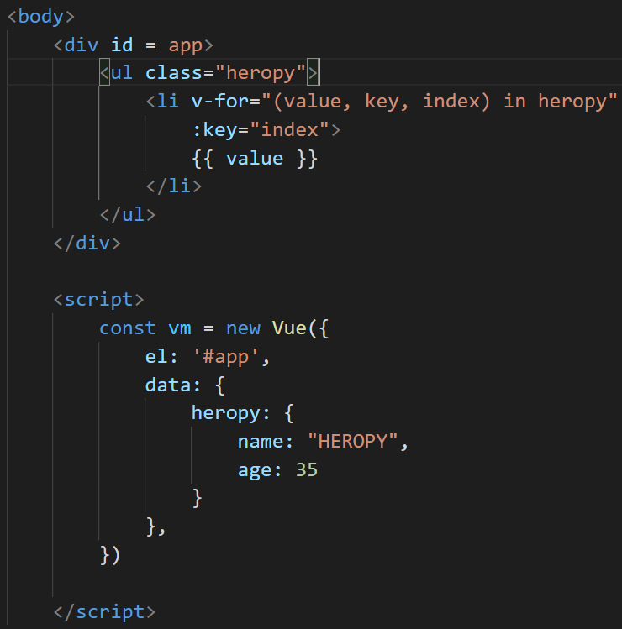
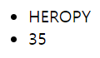
List Rendering - Object

Slide 5
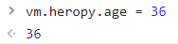
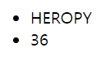
List Rendering - Object

Slide 6
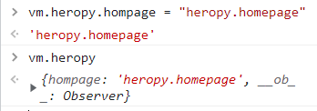
List Rendering - Object

Slide 7
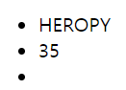
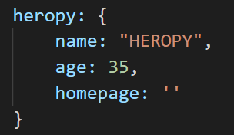
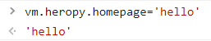
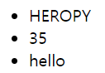
List Rendering - Object

Slide 8
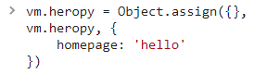
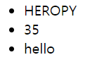
List Rendering - Object

Slide 9

Q&A

